Slide 1
The benefit and Risks of Nutritional Supplements
Peiying Yang, Ph.D.
Department of General Oncology
The University of Texas M.D. Anderson Cancer Center

Slide 2
Dietary Supplements
Congress defined the term "dietary supplement" in the Dietary Supplement Health and Education Act (DSHEA)
“A dietary supplement is a product taken by mouth that contains a "dietary ingredient" intended to supplement the diet. The "dietary ingredients" in these products may include: vitamins, minerals, herbs or other botanicals, amino acids, and substances such as enzymes, organ tissues, glandulars, and metabolites.”

Slide 3
FDA Regulations
Dietary Supplement Health and Education Act (DSHEA) was assigned into law by President Clinton in 1994
Create a new regulatory framework for the safety and labeling of dietary supplements
A firm is responsible for the safety of product
Dietary supplements do not need approved by FDA before they are marketed
No health claim is allowed in the product

Slide 4
CAM Use in US in 2010

Slide 5
Dietary Supplement Use in US

Slide 7
Guidance for Dietary Supplements
Are dietary supplements safe?
Benefit and Risk?
How to buy the dietary supplements?
What cautions need to be taken for buying or taking the nutritional supplement?

Slide 8
Benefits
Augment the intake of nutrients that your diet is lacking under normal or pathological conditions
Treat specific health conditions or risk factors:
- Folic acid used to reduce the spina bifida
- Omega-3 used to reduce the triglycerides (Lovaza)
Need more scientific evidence

Slide 9
Risk
Toxicity
- Large dose
- wrong application
- Poor quality product
Interaction with over counter or prescription medications
Not enough evidence for the safety

Slide 10
Omega-3 fatty acids – fish and flaxseed oil

Slide 11
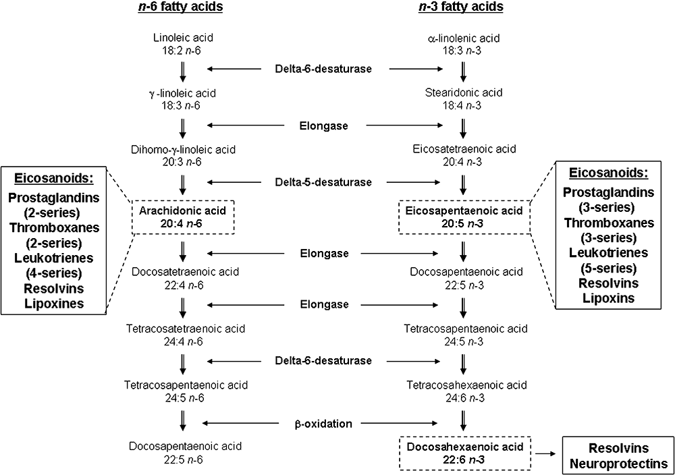
Metabolism of omega-6 and omega-3 fatty acids

Slide 12


Fish Oil and Omega-3 Fatty Acids
Polyunsaturated fatty acids
Three major omega-3 fatty acids:
- Alpha-linoleic acid (ALA, Flaxseed)
- Eicosapentaenoic acid (EPA, fish)
- Docosahexaenoic acid (DHA, fish)
Most American diets provide at least 10 times more omega-6 than omega-3.

Slide 13
Dietary Source of Omega-3 Fatty Acids
Food | Serving | omega-3 fatty acids | % DV | Density | Quality
Flax seeds | 0.25 cups | 7.0 g | 156.4 | 17.6 | Excellent
Walnuts C | 0.25 cup | 2.3 g | 50.4 | 6.3 | Very good
Chinook salmon, baked/broiled | 4.0 oz-wt | 2.1 g | 46.4 | 3.6 | Very good
Scallops, baked/broiled | 4.0 oz-wt | 1.1 g | 24.4 | 3.3 | Good
Soybeans, cooked | 1 cup | 1.0 g | 22.9 | 1.6 | Good
Halibut, baked/broiled | 4.0 oz-wt | 0.6 g | 13.8 | 1.8 | Good
Shrimp, steamed, boiled | 4.0 oz-wt | 0.4 g | 8.2 | 1.5 | Good
Snapper, baked | 4.0 oz-wt | 0.4 g | 8.0 | 1.1 | Good
Tofu, raw | 4.0 oz-wt | 0.4 g | 8.0 | 1.9 | Good
Winter squash | 1 cup | 0.3 g | 7.6 | 1.9 | Good
Tuna, yellowfin | 4.0 oz-wt | 0.3 g | 7.3 | 0.9 | -
Cod, baked | 4.0 oz-wt | 0.3 g | 7.1 | 1.2 | -
Kidney beans | 1 cup | 0.3 g | 6.7 | 0.6 | -
Note: Algae oils are the vegetarian source of DHA.

Slide 14
Flaxseed and Fish Oil Supplements
Total of 136 products containing Flaxseed powder or Flaxseed oil
Fish oil:
- Fish oil in triglyceride form- Nordic Natural
- Fish oil in ethyl ester form – Lovaza
- Fish oil in phospholipid form – Krill oil
Ratio of EPA and DHA in fish oil
- 3:2 (menhaden oil, ultimate omega)
- 4:1 (EPA, Nordic Natural)
- 1:5 (DHA, Nordic Natural)

Slide 15
“Does fish oil (鱼油）provide a rationale treatment strategy for cancer?”
Anti-inflammatory
Cardiovascular protection
Fish oil
(n-3 fatty acids)
Augments cytotoxic effects of chemotherapy
Immune modulation
Anti-tumor ?

Slide 16
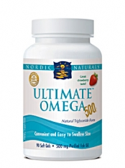
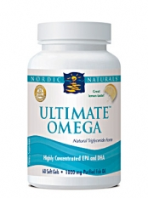
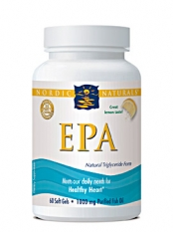
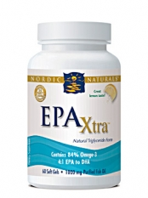
Challenges of Choosing the Right Supplements
EPA/DHA 325:225
EPA/DHA 650:450
EPA/DHA 850:200
EPA/DHA 1060:274
Quality of products – Source of fish oil and contaminations
Right amount of total omega-3 fatty acids needed
Special ratio of EPA/DHA
Healthy and pathological conditions
USP certification? (Fish oil made by Kirkland Signature, Nutri Plus or Nature Made)

Slide 17
Metabolism of AA and EPA to the Prostaglandin Subfamily of Eicosanoids
Study suggested that PGE2 promote the proliferation, invasion and metastasis of tumor; whereas PGE3 inhibits the proliferation of various cancer cells.
Yang, P. et al, Journal of Lipid Research, 2004

Slide 18
Hypothesis
Anti-tumor activity of fish oil n-3 fatty acids is associated with inhibition of PGE₂ formation and concomitant increased formation of PGE₃ in NSCLC cells

Slide 19
Genetically deletion of COX-2 gene reduced EPA elicited anti-proliferative activity in A549 cells

Slide 20
The inhibitory effect of EPA or PGE3 in A549 cells was mediated through PI3kinase pathways

Slide 21
Fish Oil derived n-3 Fatty acid EPA inhibits proliferation of NSCLC cells mediated through COX-2 pathways

Slide 23
Fish oil and non-Hodgkin lymphoma
Specific Aim 1: To identify the effect of EPA and DHA alone or in combination on growth of human NHL cells BJAB (COX-2 over-expressing) and RAJi (COX-2 lacking) cells.
Specific Aim 2: To examine eicosanoid metabolism in human normal B cells and NHL cells after exposure to EPA and DHA.
Specific Aim 3: To evaluate the efficacy of EPA, DHA and these two agents combined on tumor growth and eicosanoid metabolism in mouse models of human NHL.
Specific Aim 4: To determine the effect of PGE₂ and PGE₃ on cell proliferation, mobility and cAMP-PKA and PI3K/Akt signaling pathways in human normal B cells and NHL cells.
Proposed mechanism of PGE₂ and PGE₃ mediated cell proliferation and angiogenesis.

Slide 24
Chemopreventive effect of fish oil derived EPA in lung cancer
To identify the relationship of COX-2 and EPA on lung tumor development using urethane-treated wild-type and COX-2 deficient FVB mice, and Kras-transgenic mice.
- EPA and Lovaza, an FDA approved fish oil product will be the study agents
- Anti-Inflammation and tumor development as the end points
- Eicosanoids, particularly PGE₂, PGE₃ and their metabolites as the biomarkers
To determine the tumor growth-suppressing effects in vitro of different ratios of PGE₃:PGE₂ and the mechanisms by which these effects occur. The effects will be assessed in the COX-2 expressing or COX-2 null human lung cancer cells.
To identify the role of PGE₂ receptors in the anti-proliferative effect of fish oil-derived PGE₃.
- Binding capacity of PGE₂ and PGE₃ to EP receptors
- Cell signaling of EP2 and EP4 receptors response to PGE₂ and PGE₃
- Chemopreventive effect on urethane-induced lung cancer in EP2 and EP4 knockout mice

Slide 25
Study agent:
4 1-g gelatin capsules per day containing 2.2 g EPA and 240 mg DHA (EPA: DHA; 9:1)
7.5 ml liquid fish oil per day (2.2 g EPA and 500 mg DHA; EPA:DHA; 4:1)

Slide 26
No special information was provided with respect to the type of fish oils administered.

Slide 27
Expression of the Fat-1 gene diminishes prostate cancer growth in vivo through enhancing apoptosis and inhibiting GSK-3 beta phosphorylation

Slide 28
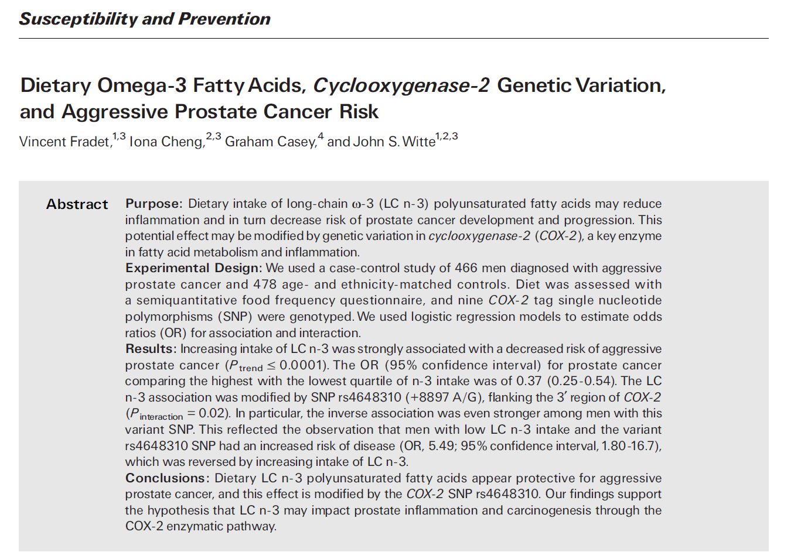

Slide 29
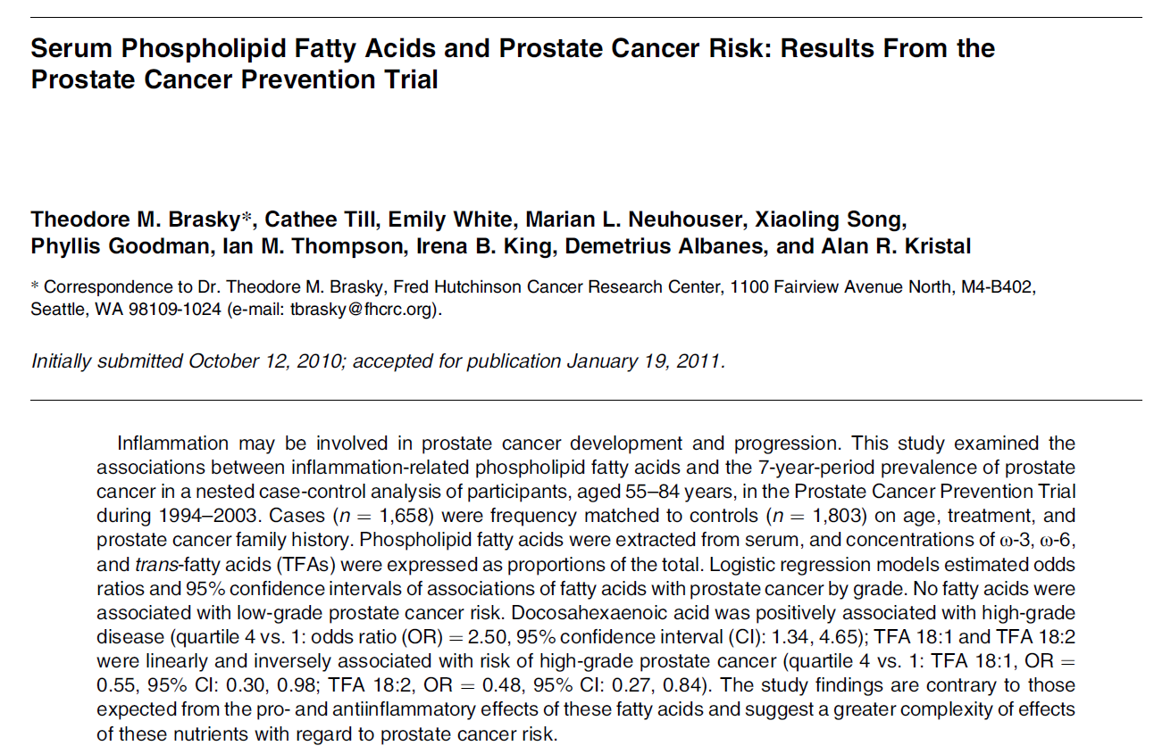

Slide 30
Is Flaxseed safe for someone with breast cancer?
Flaxseed powder is a rich source of lignans which has ability to influence estrogen production and metabolism

Slide 31
The effect of flaxseed and breast cancer
Reduced tumor growth and sensitises tamoxifen treatment of MCF-7 xenograft model either at regular or high levels of circulating estrogen (Truan JS, et al., Mol Nutr Food Res, 2010; Chen J, J Nutr, 2009)
Flaxseed powder decreased release of IL-1β derived from murine stroma and microvessel density, suggesting inhibition of angiogenesis in breast cancer.
Flaxseed oil (Pizzey Nutritionals, Canada) augmented tumor-reducing effects of trastuzumab (primary drug for HER2 positive patient) in HER2 overexpressing tumor (BT-474).
Flaxseed powder did not alter the estrogen metabolism in postmenopausal women (Strugeon SR, et al., Nutr Cancer, 2010)
Flaxseed powder attenuated soy protein isolate induced breast cancer development in MCF-7 bearing mice, suggesting soy protein and flaxseed differentially modulate tumor markers and cell signaling pathways (Power KA, et al., J Steroid Biochem Mol Biol, 2008)
Mechanistically, Flaxseed has ability to inhibit angiogenesis, IGF-1alpha, and VEGF pathways.
The inhibitory effect of flaxseed on the growth and metastasis of estrogen receptor negative human breast cancer xenograftsis attributed to both its lignan and oil components.

Slide 32
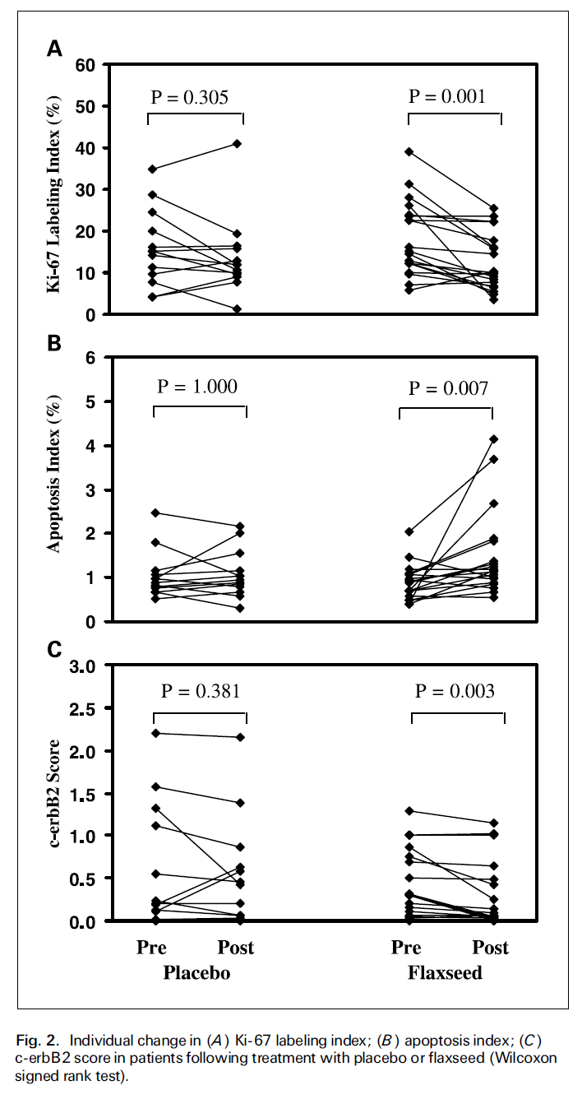

Slide 33
Soy: another phytoestrogen containing food

Slide 35
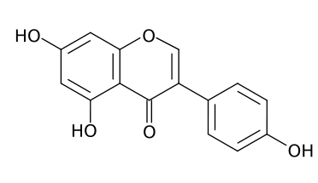
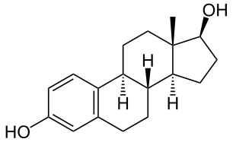
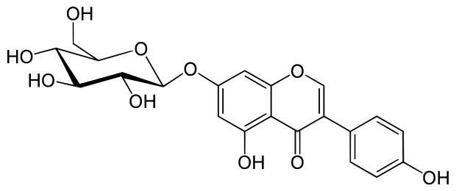
Structure of Estrodial and Phytoestrogen in Soy
Genistein
Estrodial
Genistin

Slide 36
Soy Phytoestrogen and Estrogen Receptors (ERs)
Two estrogen receptors: ERα and ERβ
ERα mediates the proliferative actions of estrogens; whereas ERβ binds to ERα and inhibits its action
ERβ is expressed at a significantly higher level than ERα during early development and normal adult breast
Levels of ERα are higher than that of ERβ in breast tumor
Genistein preferably binds to ERβ particularly when it is at relatively lower dose (~5-8 nM), but it does have equal binding capability to ERα like estrodial.
Genistein appears bind and activate ERα in breast tumor because it upregulates estrogen responsive genes, such as pS2 and c-fos.

Slide 37
The Effect of Phytoestrogens and Other Soy Products on the Growth of MCF-7 Xenograft Models

Slide 38
Plausible Mechanism of Genistein

Slide 39
Results of Western Women Studies
No protective effect
Almost significantly increased risk of recurrence among those not taking tamoxifen and having the highest intake of genistein and daidzein
Total of 1954 patients were included in this study

Slide 40
Results of Chinese Women Studies
Significantly reduced risk of recurrence with highest level of isoflavones and soy protein in their diet
Total of 5042 breast cancer survivors

Slide 41
Challenges of Soy Studies
Marked differences in the products used in the studies;
-Whole soy foods (Chinese)
- Soy proteins (Western)
Difference on the ages starting consuming soy products
The genetic difference between western and Chinese with respect to absorption and digestion of soy
Other dietary components ingested routinely

Slide 42
Plausible Conclusions
Soy intake during childhood and adolescence might provide lifelong protection against breast cancer
Reduction of risk of recurrence in Asian women consuming soy regularly
Lifetime soy consumption at a moderate level may prevent breast cancer recurrence

Slide 43
Vitamin D
Fat soluble vitamin or sunshine vitamin or a hormone
Structurally, it belongs to secosteroids
Increasing the efficiency of intestinal calcium and phosphate absorption for the maintenance of the skeleton throughout life
Deficiency of Vitamin D is linked to increased risk for preeclampsia, multiple sclerosis, rheumatoid arthritis, diabetes, heart disease, dementia, deadly cancers.

Slide 44
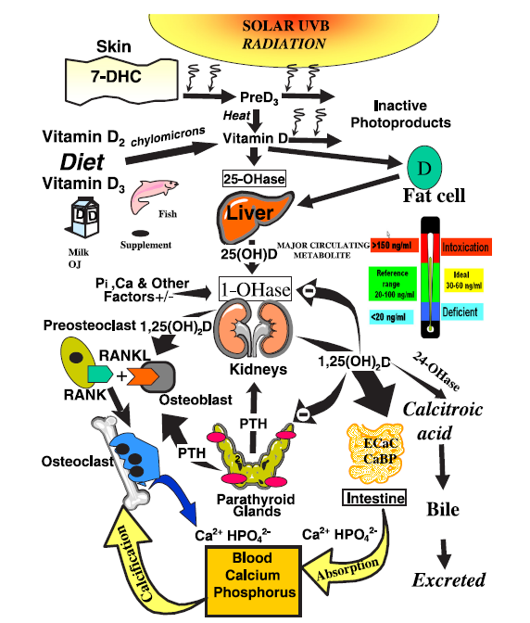
Overview of source and function of Vitamin D
Holick, M., J Investigative Med, 2011

Slide 45
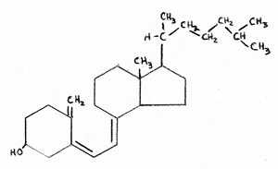
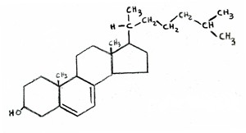
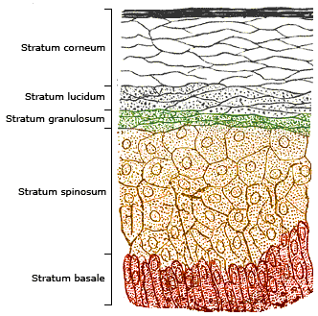
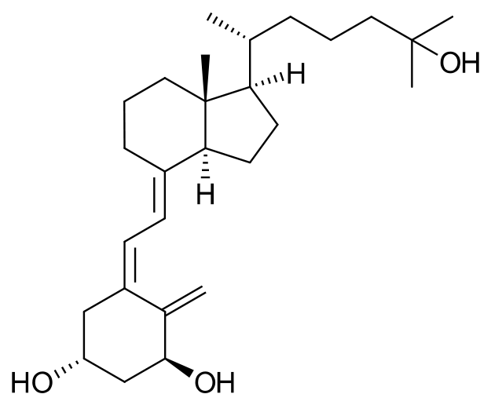
Synthesis of Vitamin D3 in Normal Skin
UV light
9 am to 4 pm
7-hydroxycholeterol
Cholecalciferol (Vitamin D3)
Liver or kidney
1,25-dihydroxyCholecalciferol

Slide 46
Selected food Source for Vitamin D
Food | IUs per serving* | Percent DV**
Cod liver oil, 1 tablespoon | 1,360 | 340
Salmon (sockeye), cooked, 3 ounces | 447 | 112
Mackerel, cooked, 3 ounces | 388 | 97
Tuna fish, canned in water, drained, 3 ounces | 154 | 39
Orange juice fortified with vitamin D, 1 cup (check product labels, as amount of added vitamin D varies) | 137 | 34
Milk, nonfat, reduced fat, and whole, vitamin D-fortified, 1 cup | 115–124 | 29–31
Yogurt, fortified with 20% of the DV for vitamin D, 6 ounces (more heavily fortified yogurts provide more of the DV) | 88 | 22
Margarine, fortified, 1 tablespoon | 60 | 15
Liver, beef, cooked, 3.5 ounces | 49 | 12
Sardines, canned in oil, drained, 2 sardines | 46 | 12
Egg, 1 large (vitamin D is found in yolk) | 41 | 10
Ready-to-eat cereal, fortified with 10% of the DV for vitamin D, 0.75–1 cup (more heavily fortified cereals might provide more of the DV) | 40 | 10
Cheese, Swiss, 1 ounce | 6 | 2
* IUs = International Units.
** DV = Daily Value. DVs were developed by the U.S. Food and Drug Administration to help consumers compare the nutrient contents among products within the context of a total daily diet.

Slide 47
Vitamin D and Cancer
Vitamin D has ability to decrease proliferation of prostate, colon, ovarian and renal carcinoma as well as lymphoma and melanoma cells.
Higher 25(OH)D has a protective effect in the development of colorectal adenoma and carcinomas.
Plasma 25(OH)D was inversely associated with risk of colorectal and prostate cancer

Slide 48
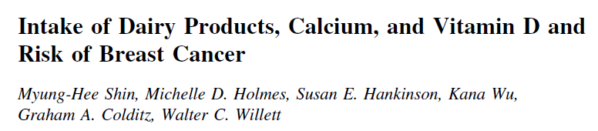
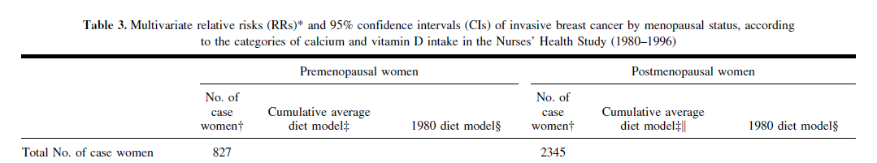
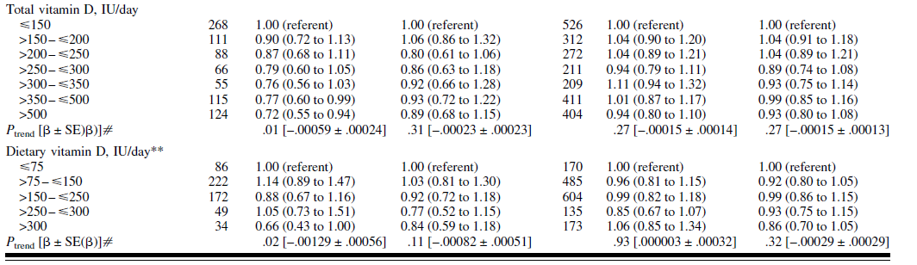
Among premenopausal women, high intake of vitamin D and calcium was associated with reduced risk of breast cancer, but difference between Vitamin D and calcium was not distinguishable.

Slide 49

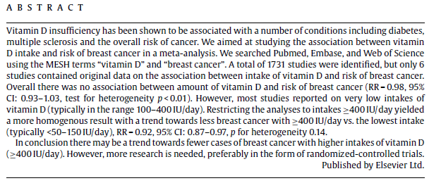
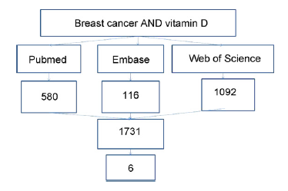
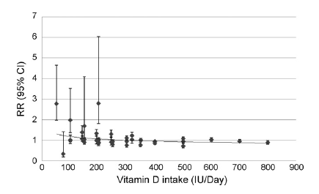
Summary of literature search

Slide 50
Breast cancer survivors and vitamin D: A review
Stephanie L. Hines, M.D.a, H. Keels S. Jorn, M.D.b, Kristine M. Thompson, M.D.c, Jan M. Larson, M.D.d
Abstract
Recent evidence has suggested a role for vitamin D in breast cancer prevention and survival. Studies have reported an inverse relation between vitamin D intake and the risk of breast cancer, improvements in survival after a diagnosis of breast cancer in women with higher levels of vitamin D, and vitamin D insufficiency in up to 75% of women with breast cancer. Preclinical data have indicated that vitamin D affects up to 200 genes that influence cellular proliferation, apoptosis, angiogenesis, terminal differentiation of normal and cancer cells, and macrophage function. Vitamin D receptors have been found in up to 80% of breast cancers, and vitamin D receptor polymorphisms have been associated with differences in survival. Although ongoing studies have investigated a possible link between adequate levels of vitamin D and improved cancer prognosis, breast cancer survivors may derive additional, non–cancer-related benefits from adequate vitamin D levels, including improvements in bone mineral density, quality of life, and mood. Maintaining adequate vitamin D stores is recommended for breast cancer survivors throughout their lifetime.
Nutr 2010

Slide 51
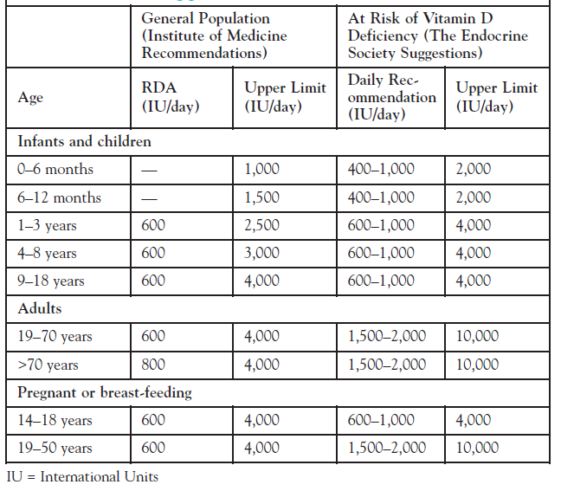
Suggested Vitamin D Intake by Institute of Medicine and Endocrine Society
Patient guidance to vitamin D deficiency,

Slide 52
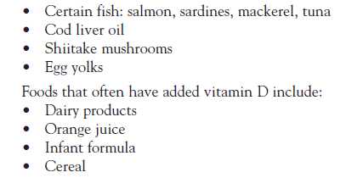
Sources for Natural Vitamin D
Sun Exposure 10 to 15 min between 9 am to 4 pm
Avoid Sunscreen protector except on face
Foods rich in natural vitamin D

Slide 53
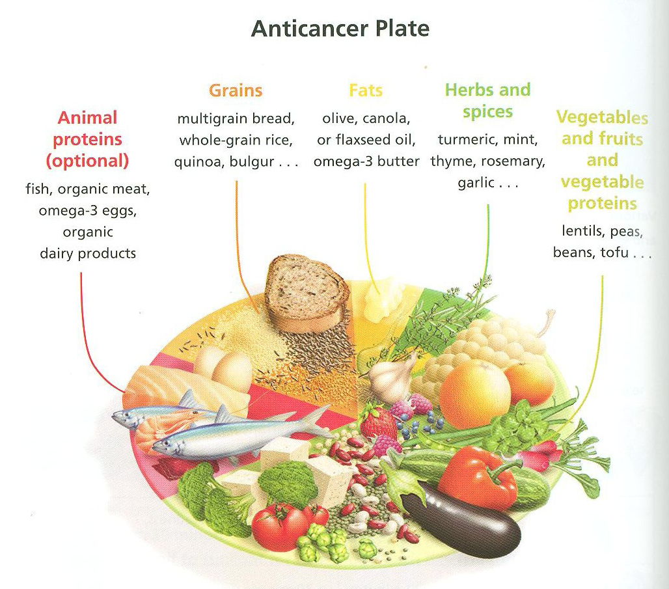

Slide 54
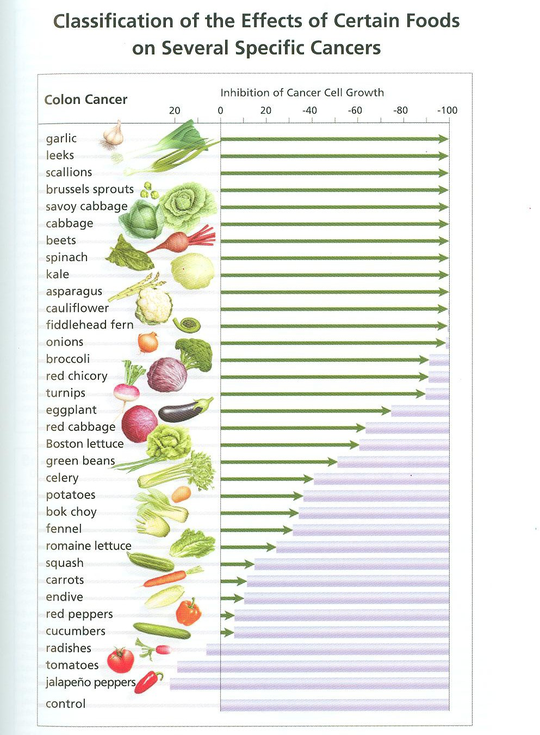

Slide 55
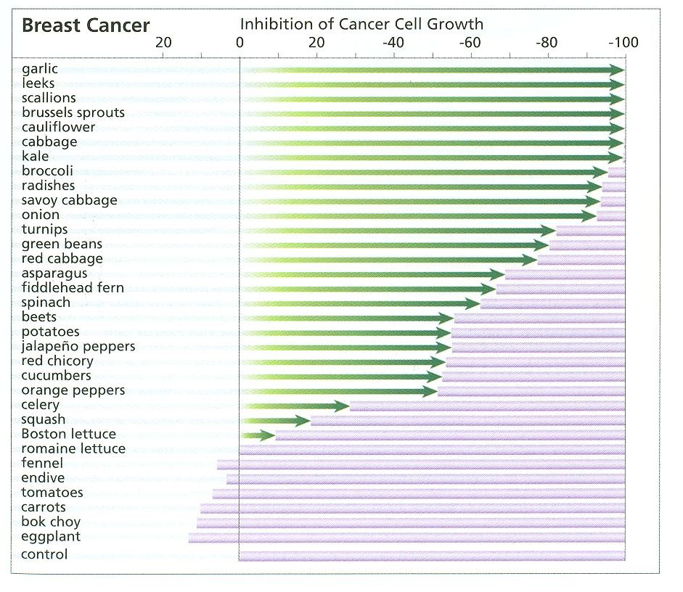
The effect of Vegetables on the Proliferation of Breast Cancer Cells

Slide 56
Potential foods that may help against breast cancer
Brassica vegetables like broccoli, cauliflower and cabbage
Linseed/Flaxseed and berries
Vitamin D rich food
Fish oil
Green tea
Mushroom

Slide 57
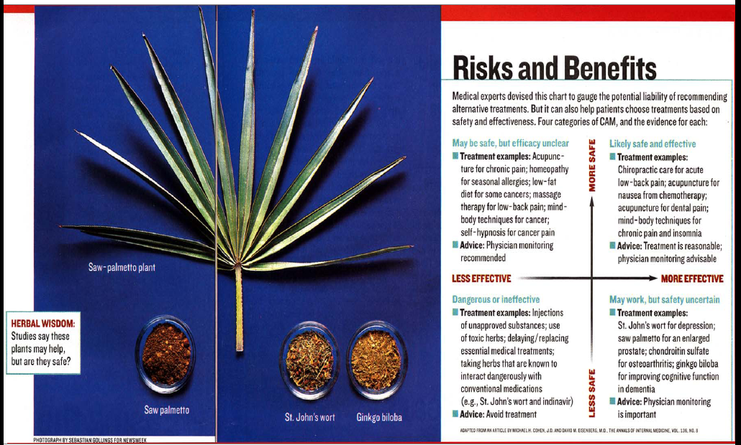
The Balance !!

Slide 58
SUMMARY
Nutritional supplements would be beneficial for cancer care when they are administered in the right dose, at right time, and for the right people
Administration of nutritional supplements should be limited during chemo- or radiation treatment
Dietary source of anti-inflammatory and anticancer phytochemicals would still be preferable comparing to the concentrated extracts
More vigorous studies on this particular field are definitely needed

Slide 59
Books
Anti-cancer - A new way of life, by
David Servan- Schreiber
Life After Cancer by Keith Block

